Slide 1

University of diyala –college of engineering – mechanical department
Engineering control----- Forth class Dr. Ekhlas edan kader
1-Course Description:
a-Basic Concepts. System, control system, input, output, open-loop and closed loop control systems, elements of a general control system, examples of control system.
b-Mathematical Modeling of Physical System. Free body diagram and Newton‟s law of motion,
operational notation, grounded chair representation, series parallel laws, equations of motion for spring mass damper systems, levered system, rotational system, geared system, electrical components and R.L.C circuits, electrical analogies for mechanical systems, scale factors, thermal systems and fluid system.
C-Transfer Functions and Systems Response. Review of Laplace transform, impulse, step and ramp functions, concept of transfer functions of common components, block diagram algebra, signal flow graphs, impulse, step, and ramp response of first and second order systems, characterization of response (time constant, gain, overshoot, rise time, setting time, steady state error, etc.) relation of system response to location of system poles and zeros.
d-Stability of Control System. Concept of stability, Routh Hurwitz criterion.
f-Root locus Methods and its Use in Control System Design Introduction to Digital Control Significance of measurement, planning of experiments, general measurement system, calibration, static and dynamic measurement sensitivity, range, accuracy precision, repeatability, and uncertainty of instruments, measurement errors. Instruments for measurement of length, force, torque, frequency, pressure, flow and temperature. Introduction to data acquisition through computers. A/D and D/A converters.
2-Recommended Books
Automatic Control, by Francis H. Raven
Modern Control System, by Richard C. Dorf
Automatic Control Systems, by B.B. Kuo
Measurement Systems Applications and Design, by E. Doeblin, McGraw Hill
Theory and Design for Mechanical Measurements, by R. Figliola, And D. Beasley, John Wiley.
I ةحفصلا
Dr.Ekhlas Edan

Slide 2
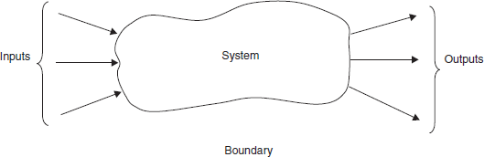
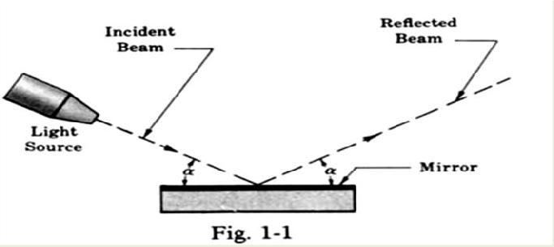
Lecture one Introduction
Modern control theory is concerned with systems that have self-organizing, adaptive, robust, learning, and optimum qualities. The control of an industrial process (manufacturing, production, and so on) by automatic rather than manual means is often called automation. Automation is prevalent in the chemical, electric power, paper, automobile, and steel industries, among others. The concept of automation is central to our industrial society. Automatic machines are used to increase the production of a plant per worker in order to offset rising wages and inflationary costs. Thus industries are concerned with the productivity per worker of their plants. Productivity is defined as the ratio of physical output to physical input. In this case, we are referring to labor productivity, which is real output per hour of work.
Furthermore, industry seeks to provide products that are increasingly precise, reliable, accurate, and robust. For example, precise, reliable control of automobile performance has improved markedly over the past decades.
Control systems are used to achieve (1) increased productivity and (2) improved performance of a device or system. Automation is used to improve productivity and obtain high-quality products. Automation is the automatic operation or control of a process, device, or system. We utilize automatic control of machines and processes to produce a product within specified tolerances and to achieve high precision.
Control systems
In modern usage the word system has many meanings. So let us begin by defining what we mean when we use this word in this book, first abstractly then slightly more specifically in relation to scientific literature.
A system is an arrangement, set, or collection of things connected or related in such a manner as to form an entirety or whole. Or A system is an arrangement of physical components connected or related in such a
manner as to form and/or act as an entire unit.
The word control is usually taken to mean regulate, direct, or command. Combining the above definitions, we have. A control system is an arrangement of physical components connected or related in such a manner as to command, direct, or regulate itself or another system. In the most abstract sense it is possible to consider every physical object a control system. Everything alters its environment in some manner, if not actively then passively-like a mirror directing a beam of light shining on it at some acute angle. The mirror (Fig. 1-1) may be considered an elementary control system, controlling the beam of light according to the simple equation “the angle of, reflection a equals the angle of incidence a.”
The plant (or process, or controlled system) is the system, subsystem, process, or object controlled by the feedback control system .It is important to note, however, that control systems of interest for analysis or design purposes include not only those manufactured by humans, but those that normally exist in nature, and control systems with both manufactured and natural components.
The input is the stimulus, excitation or command applied to a control system, typically from an external energy source, usually in order to produce a specified response from the control system.

Slide 3


The controlled output c is the output variable of the plant, under the control of the feed back control system.
The forward path is the transmission path from the summing point to the controlled output c.
The feedforward (control) elements, are the components of the forward path that generate the control signal U or m applied to the plant. Note: Feed forward elements typically include controller(s), compensator(s) (or equalization elements), and/or amplifiers.
The actuating (or error) signal is the reference input signal r plus or minus the primary feedback signal b.
The control action is generated by the actuating (error) signal in a feedback control system . Note: In an
open-loop system, which has no feedback, the actuating signal is equal to r .
Control System Classification
a component or process to be controlled can be represented by a block(contain names or process to be controlled), as shown in Figure 1.1.ش
The input-output relationship represents the cause-and-effect relationship of the process, which in turn represents a processing of the input signal to provide an output signal variable, often with a power amplification.
An open-loop control system uses a controller and an actuator to obtain the desired response, A system in which the output has no effect on the control action is known as an open loop control system. For a given input the system produces a certain output. If there are any disturbances, the output changes and there is no adjustment of the input to bring back the output to the original value. No measurements are made at the output as shown in Figure 1.2. An open-loop system is a system without feedback. A traffic control system is a good example of an open loop system. The signals change according to a preset time and are not affected by the density of traffic on any road. A washing machine is another example of an open loop control system. The quality of wash is not measured; every cycle like wash, rinse and dry' cycle goes according to a preset timing.
closed-loop control system utilizes an additional measure of the actual output to compare the actual output with the desired output response.
A system which maintains a prescribed relationship between the controlled variable and the reference input, and uses the difference between them as a signal to activate the control, is known as a feedback control system. The output or the controlled variable is measured and compared with the reference input and an error signal is generated. This is the activating signal to the controller which, by its action, tries to reduce the error. Thus the controlled variable is continuously feedback and compared with the input signal. If the error is reduced to zero, the output is the desired output and is equal to the reference input signal.The measure of the output is called the feedback signal. A simple closed-loop feedback control system is shown in Figure

Slide 4
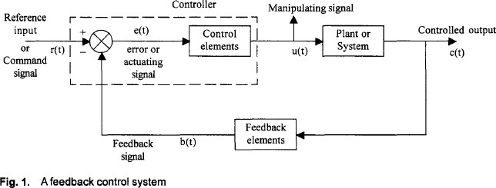
a
Open Loop Systems /
Closed Loop Systems
Open Loop Systems | Closed Loop Systems
Advantages They are simple and easy to build. They are cheaper, as they use less number of components to build. They are usually stable. Maintenance is easy. Disadvantages They are less accurate. If external disturbances are present, output differs significantly from the desired value. If there are variations in the parameters of the system, the output changes. | Advantages They are more accurate. The effect of external disturbance signals can be made very small. The variations in parameters of the system do not affect the output of the system( output less sensitive to variation is parameters, forward path components less precision, less cost ) Speed of the response can be greatly increased. Disadvantages They are more complex and expensive They require higher forward path gains. The systems are prone to instability. Oscillations in the output many occur. Cost of maintenance is high.
Classification Depending on the type of signals
the system may be classified as a (i) continuous time feedback control system or a (ii) discrete time feedback control system.
1-Continuous Time Feedback Control Systems: If the signals in all parts of a control system are continuous functions of time, the system is classified as continuous time feedback control system. Typically all control signals are of low frequency and if these signals are un modulated, the system is known as a d.c. control system. These systems use potentiometers as error detectors, d.c amplifiers to amplify the error signal, d.c. servo motor as actuating device and d.c tachometers or potentiometers as feedback elements. If the control signal is modulated by an a.c carrier wave, the resulting system is usually referred to as an a.c control system. These systems frequently use synchros as error detectors and modulators of error signal, a.c

Slide 5
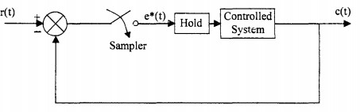
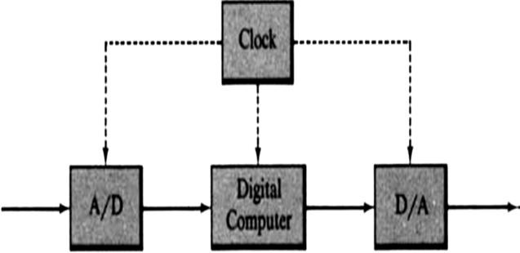
amplifiers to amplify the error signal and a.c servo motors as actuators. These motors also serve as demodulators and produce an unmodulated output signal.
2-Discrete Data Feedback Control Systems: Discrete data control systems are those systems in which at one or more pans of the feedback control system, the signal is in the form of pulses. Usually, the error in such system is sampled at uniform rate and the resulting pulses are fed to the control system. In most sampled data control systems, the signal is reconstructed as a continuous signal, using a device called hold device'. Holds of different orders are employed, but the most common hold device is a zero order hold. It holds the signal value constant, at a value equal to the amplitude of the input time function at that sampling instant, until the next sampling instant. A typical discrete data control system is shown in Fig. 1.3 which uses a sampler and a data hold.
Fig. 1.3 Discrete data control system
A digital computer or microprocessor is a discrete-time (discrete or digital) device, a common component in digital control systems. The internal and external signals of a digital computer are typically discrete-time or digitally coded.
Many digital control systems contain both continuous and discrete components. One or more devices known as samplers, and others known as holds, are usually included in such systems.
1-A sampler is a device that converts a continuous-time signal, say u ( t ) , into a discrete-time signal, denoted u*(t)
2-A hold, or data hold, device is one that converts the discrete-time output of a sampler into a particular kind of continuous-time or analog signal.
3-An analog-to-digital (A/D) converter is a device that converts an analog or continuous signal into a discrete or digital signal.
4-A digital-to-analog (D/A) converter is a device that converts a discrete or digital signal into acontinuous- time or analog signal.
Digital computers or microprocessors are often used to control continuous plants or processes.
A/D and D/A converters are typically required in such applications, to convert signals from the plant to digital signals, and to convert the digital signal from the computer into a control signal for the analog plant. The joint operation of these elements is usually synchronized by a clock and the resulting controller is sometimes called a digital filter, as illustrated in Fig.

Slide 6
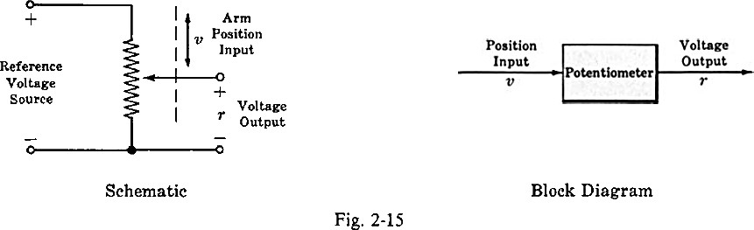
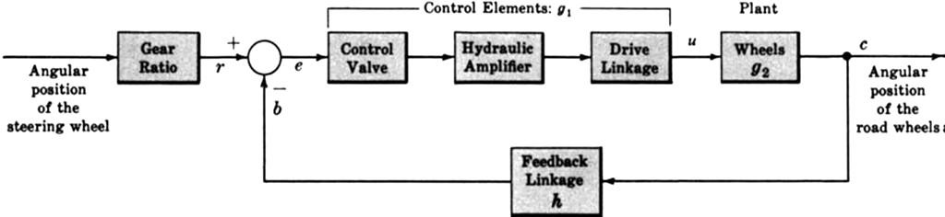
A transducer is a device that converts one energy form into another.For example, one of the most comrnon transducers in control systems applications is the potentiorneter,which converts mechanical position into an electrical voltage (Fig).
A disturbance n (or noise input) is an undesired stimulus or input signal affecting the value of the controlled output c. It may enter the plant with U or m, as shown in the block diagram , or at the first summing point, or via another intermediate point.
The time response of a system, subsystem, or element is the output as a function of time, usually following application of a prescribed input under specified operating conditions.
A servomechanism is a power-amplifying feedback control system in which the controlled variable c is
mechanical position, or a time derivative of position such as velocity or acceleration.
Example
An automobile power-steering apparatus is a servomechanism. The command input is the angular
position of the steering wheel. A small rotational torque applied to the steering wheel is amplified hydraulically, resulting in a force adequate to modify the output, the angular position of the front wheels. The block diagram of such a system may be represented by Fig. Negative feedback is necessary in order to return the control valve to the neutral position, reducing the torque from the hydraulic amplifier to zero when the desired wheel position has been achieved.
Examples of modern control systems
An electric switch is a manufactured control system, controlling the flow of electricity. By definition, the apparatus or person flipping the switch is not a part of this control system. Flipping the switch on or off may be considered as the input. That is, the input can be in one of two states, on or off. The output is the flow or nonflow (two states) of electricity. The electric switch is one of the most rudimentary control systems
A thermostatically controlled heater orfurnace automatically regulating the temperature of a room or enclosure is a control system. The input to this system is a reference temperature, usually specified by appropriately setting a thermostat. The output is the actual temperature of the room or enclosure. When the thermostat detects that the output is less than the input, the furnace provides heat until the temperature of the enclosure becomes equal to the reference input. Then the furnace is automatically turned off. When the temperature falls somewhat below the reference temperature, the furnace is turned on again
A part of the human temperature control system is the perspiration system. When the temperature of the air exterior to the skin becomes too high the sweat glands secrete heavily, inducing cooling of the skin by evaporation. Secretions are reduced when the desired cooling effect is achieved, or when the air temperature

Slide 7
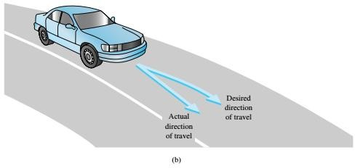
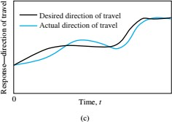
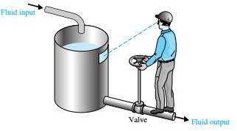
falls sufficiently. The input to this system may be “normal” or comfortable skin temperature, a “set point,” or the air temperature, a physical variable. The output is the actual skin temperature
4- driving a car
FIGURE 1.8: (a) Automobile steering control system. (b) The driver uses the difference between the actual and the desired direction of travel to generate a controlled adjustment of the steering wheel. (c) Typical direction of-travel response.
5-A basic, manually controlled closed-loop system for regulating the level of fluid in a tank is shown in Figure 1.10. The input is a reference level of fluid that the operator is instructed to maintain. (This reference is memorized by the operator.) The power amplifier is the operator, and the sensor is visual. The operator compares the actual level with the desired level and opens or closes the valve (actuator), adjusting the fluid flow out, to maintain the desired level.
FIGURE 1.10: A manual control system for regulating the level of fluid in a tank by adjusting the output valve. The operator views the level of fluid through a port in the side of the tank.
6-Other familiar control systems have the same basic elements as the system shown in Figure 1.9. A refrigerator has a temperature setting or desired temperature, a thermostat to measure the actual temperature and the error, and a compressor motor for power amplification. Other examples in the home are the oven, furnace, and water heater. In industry, there are speed controls; process temperature and pressure controls; and position, thickness, composition, and quality controls, among many others.
7-A robot is a computer-controlled machine and involves technology closely associated with automation. Industrial robotics can be defined as a particular field of automation in which the automated machine (that is, the robot) is designed to substitute for human labor. Thus robots possess certain humanlike characteristics. Today, the most common humanlike characteristic is a mechanical manipulator that is patterned somewhat after the human arm and wrist. We recognize that the automatic machine is well suited to some tasks, and that other tasks are best carried out by humans.

Slide 8

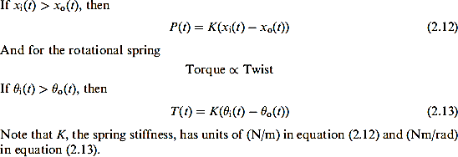
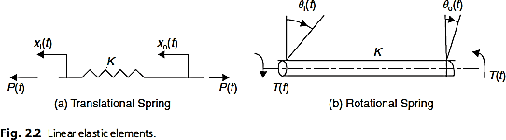
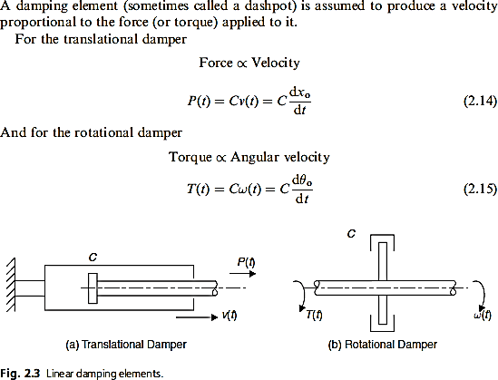
lecture two Control system models or representations
To solve a control systems problem, we must put the specifications or description of the system.Three basic representations (models) of components and systems are used extensively in the study configuration and its components into a form amenable to analysis or design. of control systems:
Mathematical models, in the form of differential equations, difference equations, and/or other 1-mathematical relations, for example, Laplace- and z-transforms
Block diagrams
Signal flow graphs
a-Mechanical system
1-Stiffness in mechanical systems
2-Damping in mechanical systems

Slide 9
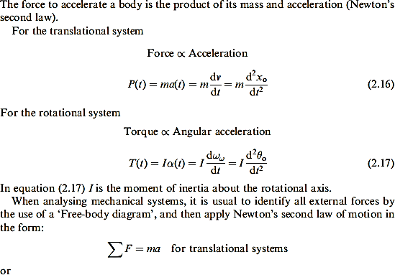
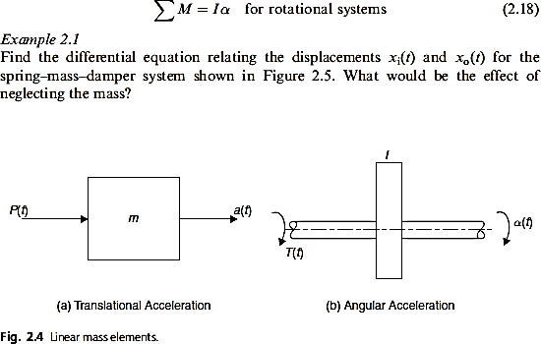
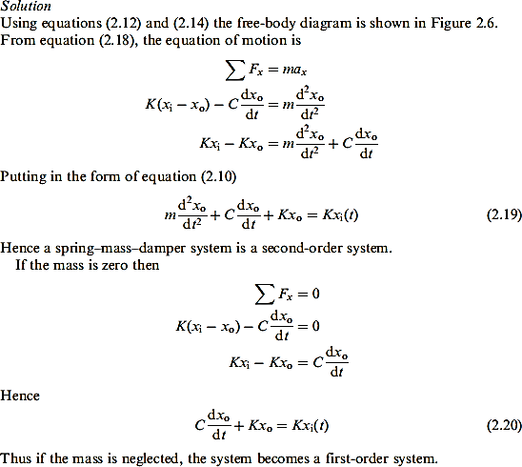
3-Force in mechanical system

Slide 10
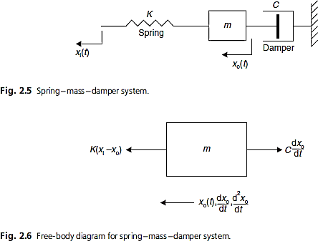
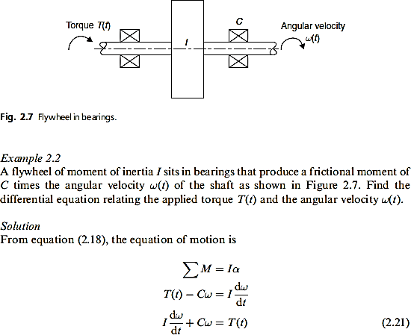
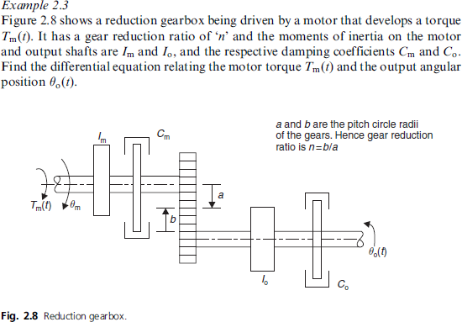

Slide 11
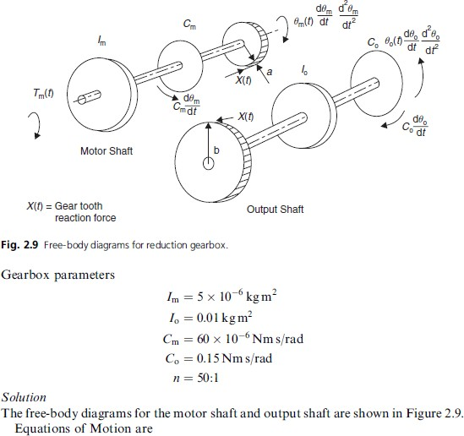
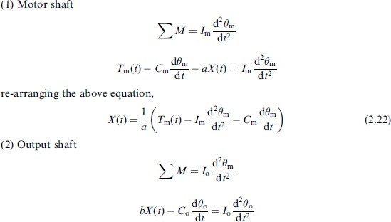

Slide 12
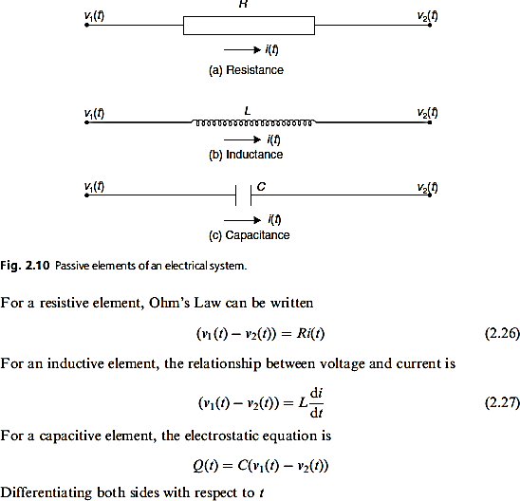
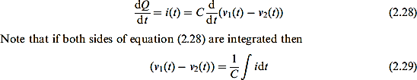

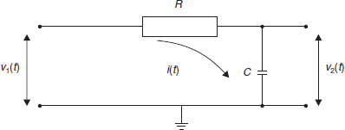

b-Electrical system

Slide 13
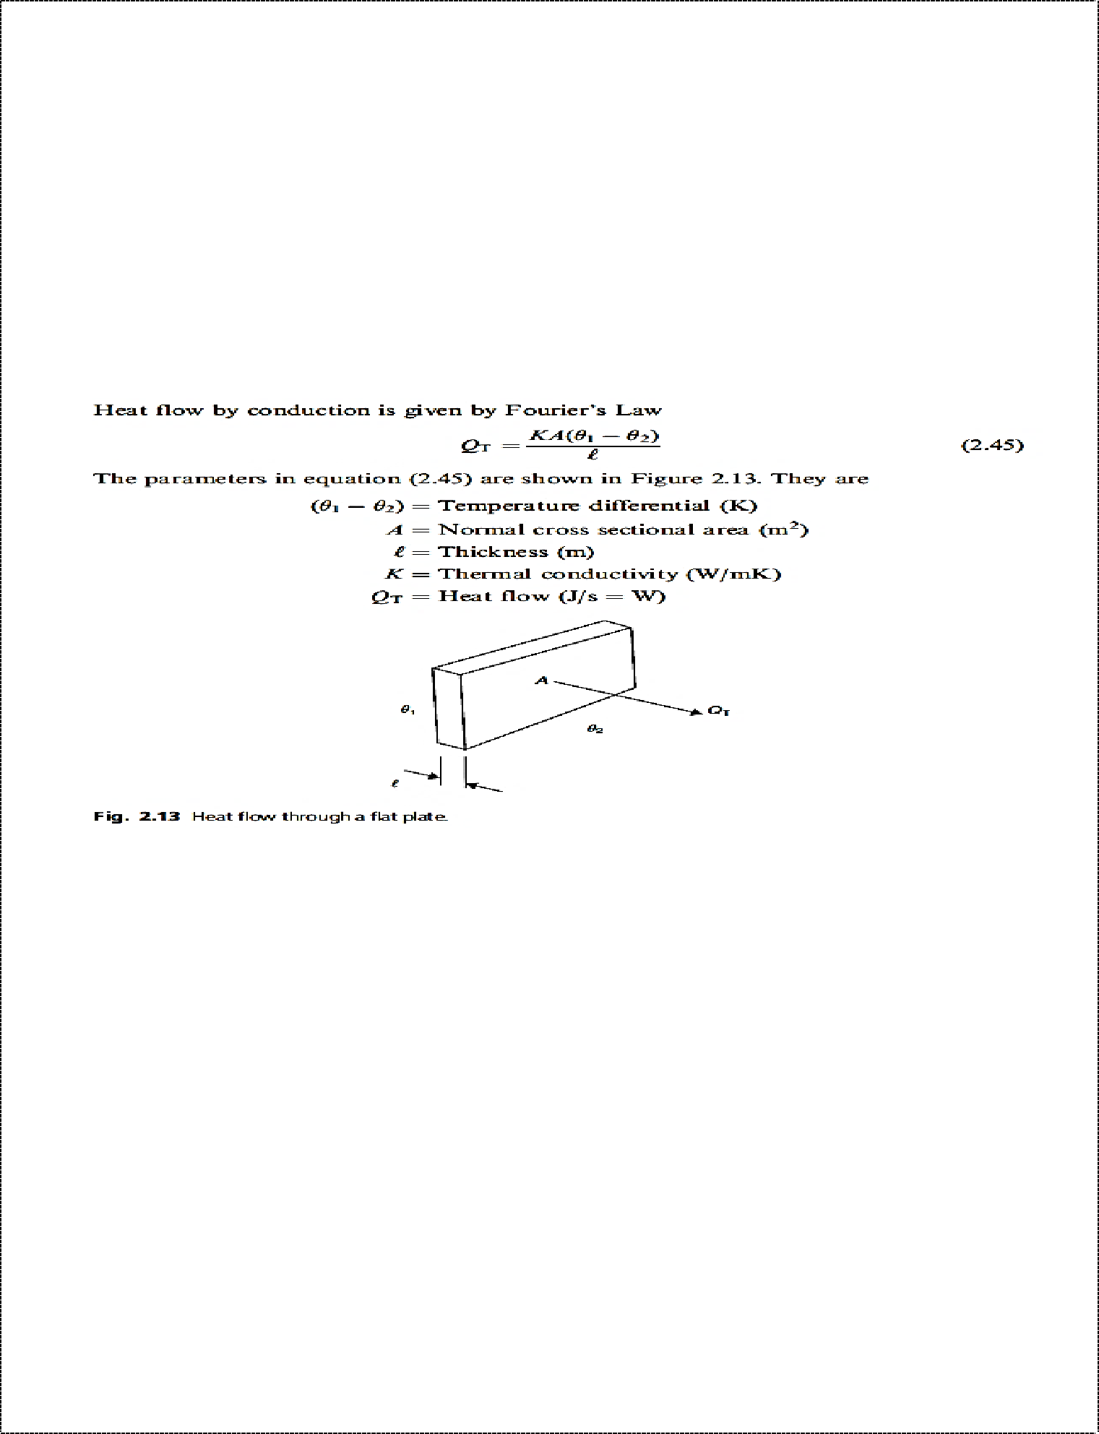
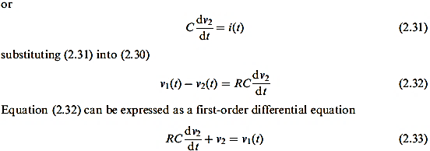
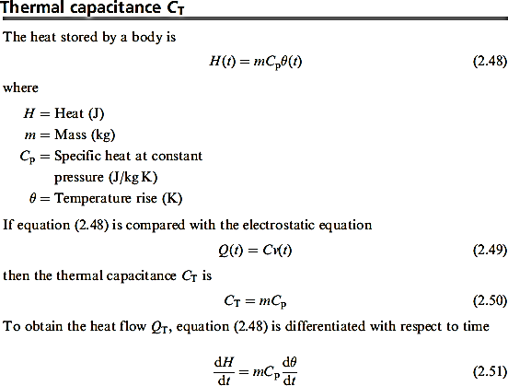
c-Thermal system
Thermal resistance R

Slide 14

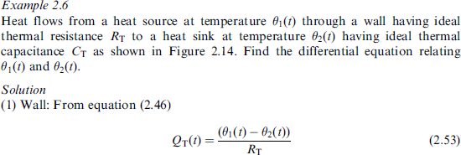
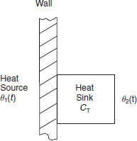
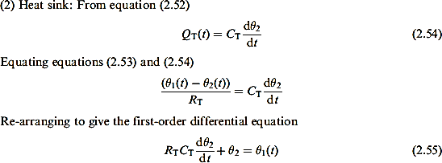

Slide 15
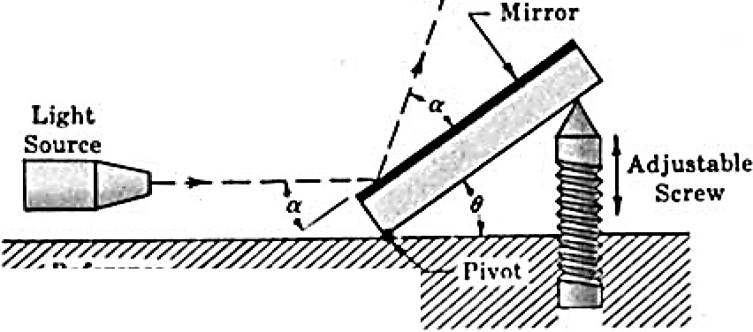
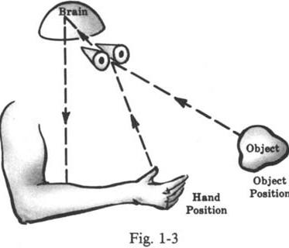
Solved Problems
1- Identify the input and output for the pivoted, adjustable mirror of Fig.
The input is the angle of inclination of the mirror θ, varied by turning the screw. The output is the angular position of the reflected beam θ + α from the reference surface.
  Identify a possible input and a possible output for a rotational generator of electricity.
The input may be the rotational speed of the prime mover (e.g., a steam turbine), in
revolutions per minute. Assuming the generator has no load attached to its output terminals,
the output may be the induced voltage at the output terminals. Alternatively, the input can be expressed as angular momentum of the prime mover shaft, and the output in units of electrical power (watts) with a load attached to the generator.
  Identify the input and output for an automatic washing machine.
Many washing machines operate in the following manner. After the clothes have been put into the machine, the soap or detergent, bleach, and water are entered in the proper amounts. The wash and spin cycle-time is then set on a timer and the washer is energized. When the
cycle is completed, the machine shuts itself off.
  Identify the organ-system components, and the input and output, and describe the operation of
the biological control system consisting of a human being reaching for an object.
The basic components of this intentionally oversimplified control system description are
the brain, arm and hand, and eyes.The brain sends the required nervous system signal to the arm and hand to reach for the object. This signal is amplified in the muscles of the arm and hand, which serve as power actuators for the system. The eyes are employed as a sensing device, continuously “feeding back” the position of the hand to the brain.Hand position is the output for the system. The input is object position. The objective of the control system is to

Slide 16
reduce the distance between hand position and object position to zero. Figure 1-3 is a schematic diagram. The dashed lines and arrows represent the direction of information flow.
( a ) Explain the operation of ordinary traffic signals which control automobile traffic at road way intersections. ( b ) Why are they open-loop control systems? (c) How can traffic be controlled more efficiently? ( d ) Why is the system of (c) closed-loop?
( a ) Traffic lights control the flow of traffic by successively confronting the traffic in a particular direction(e.g., north-south) with a red (stop) and then a green (go) light. When one direction has the green signal, the cross traffic in the other direction (east-west) has the red. Most traffic signal red and green light intervals are predetermined by a calibrated timing mechanism.
b-Control systems operated by preset timing mechanisms are open-loop. The control action
is equal to the input, the red and green intervals.
c-Besides preventing collisions, it is a function of traffic signals to generally control the
volume of traffic.
For the open-loop system described above, the volume of traffic does not influence the preset red and green timing intervals. In order to make traffic flow more smoothly, the green light timing interval must be made longer than the red in the direction containing the greater traffic volume. Often a traffic officer performs this task.The ideal system would automatically measure the volume of traffic in all directions, using appropriate sensing devices, compare them, and use the difference to control the red and green time intervals, an ideal task for a computer.
( d ) The system of ( c ) is closed-loop because the control action (the difference between the
volume of traffic in each direction) is a function of the output (actual traffic volume flowing past the intersection
in each direction).
Problems
Devise a control system to fill a container with water after it is emptied through a stopcock at the bottom. The system must automatically shut off the water when the container is filled.
Devise a simple control system which automatically turns on a room lamp at dusk,
and turns it off in daylight
Devise a closed-loop automatic toaster.
Identify the input and output for an automatic temperature-regulating oven.
Identify the input and output for an automatic refrigerator.
Identify an input and an output for an electric automatic coffeemaker. Is the system
open-loop or closed-loop?
Devise a control system to automatically raise and lower a lift-bridge to permit ships to pass. No continuous human operator is permissible. The system must function entirely automatically.
Explain the operation and identify the pertinent quantities and components of an
automatic, radar-controlled antiaircraft gun. Assume that no operator is required
except to initially put the system into an operational mode.
16

Slide 17

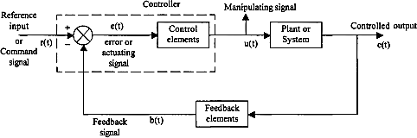
lecture three BLOCK DIAGRAMS: FUNDAMENTALS
A block diagram is a shorthand, pictorial representation of the cause-and-effect relationship between the input and output of a physical system. It provides a convenient and useful method for characterizing the „functional relationships among the various components of a control system. System components are alternatively called elements of the system. The simplest form of the block diagram is the single block, with one input and one output, as shown in Fig. 2-1.
The interior of the rectangle representing the block usually contains a description of or the name of the element, or the symbol for the mathematical operation to be performed on the input to yield the output. The arrows represent the direction of information or signal flow.
The operations of addition and subtraction have a special representation. The block becomes a small circle, called a summing point, with the appropriate plus or minus sign associated with the arrows entering the circle. The output is the algebraic sum of the inputs. Any number of inputs may enter a summing point.
Feedback Control Systems
Fig. 1.1 represents a feedback control system.
Fig. 1.1 A feedback control system
A feedback control system is represented as an interconnection of blocks characterized by an input output relation. This method of representing a control system is known as a block diagram representation. While other methods are also used to represent the control system, this is more popular. The input to the entire system is called as a reference input or a

Slide 18


command input, r(t). An error detector senses the difference between the reference input and the feedback signal equal to or proportional to the controlled output. The feedback elements measure the controlled output and convert or transform it to a suitable value so that it can be compared with the reference input. If the feedback signal, b(t), is equal to the controlled output, c(t), the feedback system is called as unity feedback system.
The difference between the reference input and the feedback signal is known as the error signal or actuating signal e(t), This signal is the input to the control elements which produce a signal known as manipulated variable, u(t). This signal manipulates the system or plant dynamics so that the desired output is obtained. The controller acts until the error between the output variable and the reference input is zero. If the feedback path is absent, the system becomes an open loop control system and is represented in Fig. 1.2.
Block Diagrams of Closed Loop Systems
The transfer function of any system can be represented by a block diagram as shown in Fig. 2.23.
Fig. 2.23 Block diagram of a system
A complex system can be modeled as interconnection of number of such blocks. Inputs to certain blocks may be derived by summing or subtracting two or more signals. The sum or difference of signals is indicated in the diagram by a symbol called summer, as shown in Fig. 2.24 (a).
Fig. 2.24 (a) Symbol of a summer (b) Pick off point
On the other hand, a signal may be taken from the output of a block and given to another block. This point from which the signal is tapped is known as pick off point and is shown in Fig. 2.24 (b). A simple feedback system with the associated nomenclature of signals is shown in Fig. 2.25.
18

Slide 19
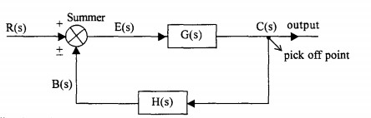

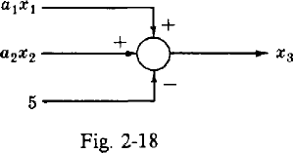
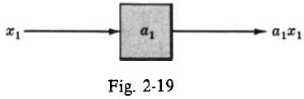
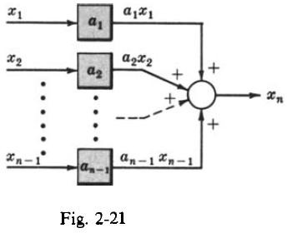
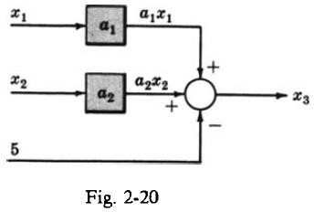

Fig. 2.25 Simple feedback system
Solved Problems
1-Consider the following equations in which xl, x2,. . . , x, are variables, and a,, a2,. . . , U
, are general coefficients or mathematical operators:
Draw a block diagram for each equation, identifying all blocks, inputs, and outputs.
2-Draw block diagrams for each of the following equations:
a-
19

Slide 20
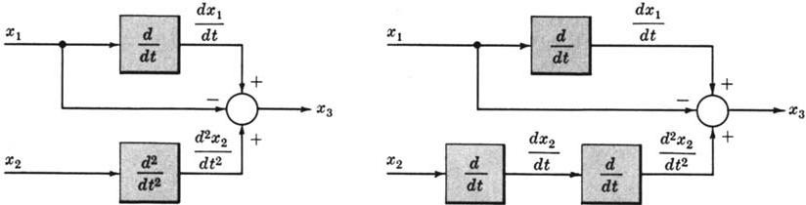

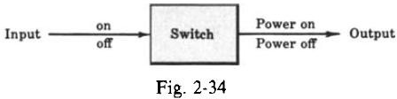
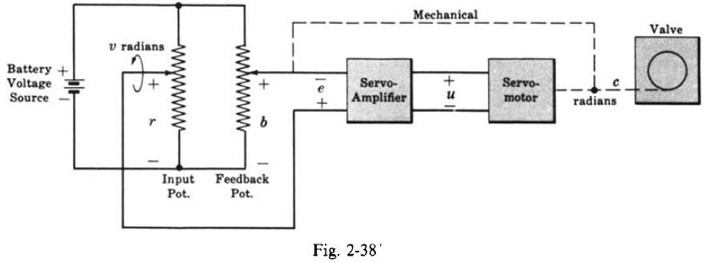
b-
c-
3- Draw a block diagram for the electric switch
4-Draw a schematic and a block diagram from the following description of a position servomechanism whose function is to open and close a water valve.
A schematic diagram (Fig. 2-38) is easily drawn from the preceding description. Mechanical
connections are shown as dashed lines.
The block diagram for this system (Fig. 2-39) is easily drawn from the schematic diagram.

Slide 21
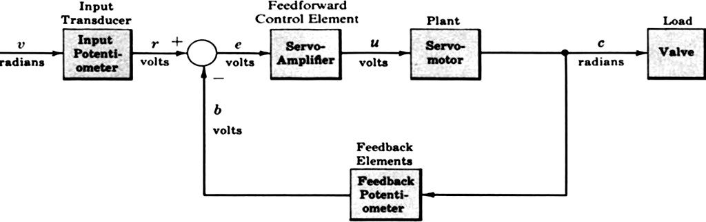
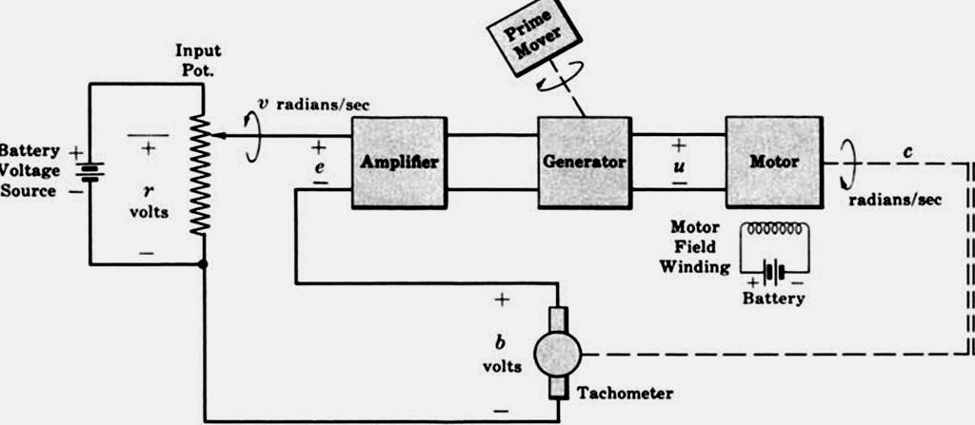
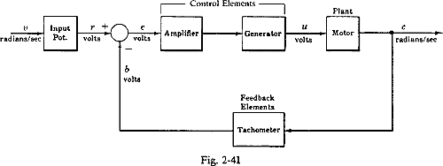
Fig. 2-39
5-Draw a block diagram for the elementary speed control system (velocity servomechanism) given in Fig. 2-40.
Fig. 2-40

Slide 22
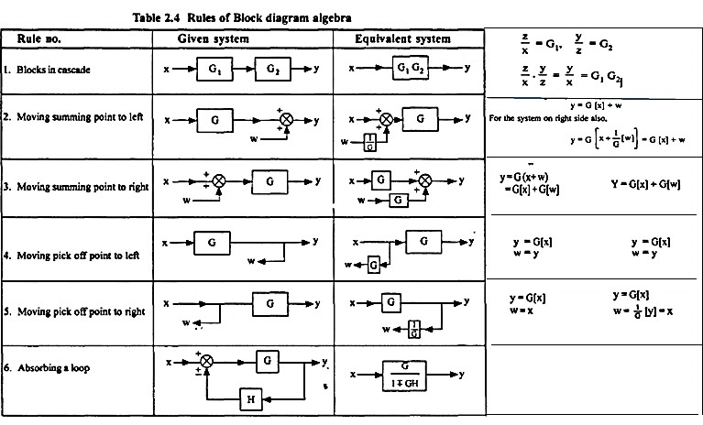
Lecture four Block Diagram Reduction Techniques
By means of systematic block diagram reduction, every multiple loop linear feedback system may be reduced to canonical form.using the following steps
Step 1: Combine all cascade blocks using Transformation 1.
Step 2 Combine all parallel blocks using Transformation 2.
Step 3: Eliminate all minor feedback loops using Transformation 4.
Step 4: Shift summing points to the left and takeoff points to the right of the major loop, using
Step 5: Repeat Steps 1 to 4 until the canonical form has been achieved for a particular input.
Step 6 Repeat Steps 1 to 5 for each input, as required.

Slide 23
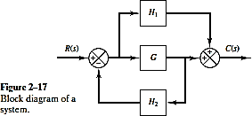
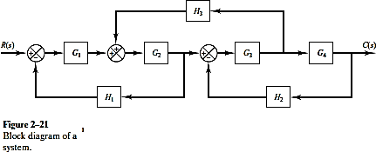
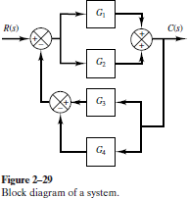
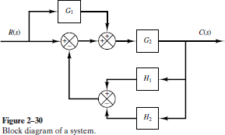
Problems
1- Simplify the block diagram shown in Figure 2–17.
2-Simplify the block diagram shown in Figure 2–21.Then obtain the closed-loop transfer function C(s)/R(s).
3-Simplify the block diagram shown in Figure 2–29 and obtain the closed-loop transfer function C(s)/R(s).
4-. Simplify the block diagram shown in Figure 2–30 and obtain the closed-loop transfer function C(s)/R(s).

Slide 24
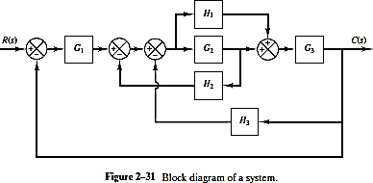


5-. Simplify the block diagram shown in Figure 2–31 and obtain the closed-loop transfer function C(s)/R(s).
6- Find the overall transfer function of the system shown in Fig. 2.33 using block diagram reduction technique.
7-Obtain the overall transfer function of the system shown in Fig. 2.34 (a).
8- Reduce the block diagram and obtain G(s) /R(s) in Fig. 2.35 (a).

Slide 25

9-Choose true or false for the following
Very few physical systems are linear within some range of the variables.
A linear system satisfies the properties of superposition and homogeneity.
The transfer function is the ratio of the Laplace transform of the output variable to the Laplace transform of the input variable, with all initial conditions equal to zero.
The flyball governor is generally agreed to be the first automatic feedback controller used in an industrial process.
A closed-loop control system uses a measurement of the output and feedback of the signal
to compare it with the desired input.
10- In the following Word Match problems, match the term with the definition by writing
the correct letter in the space provided.
1-An oscillation in which the amplitude decreases with time.------------
2-A system that satisfies the properties of superposition and homogeneity.--------------- 3-The case where damping is on the boundary between equation underdamped and
overdamped.-------------
4-A transformation of a function f(t) from the time domain into the complex frequency domain yielding F(s).---
5-The device that provides the motive power to the process.-----------------
6-A measure of damping. A dimensionless number for the second-order characteristic equation.-----------------
7-The relation formed by equating to zero the denominator of a transfer function.--------------- 8- Control of an industrial process by automatic rather than manual means is often called
a. Actuator | e. Damped oscillation | h-automation
b. Block diagrams c Characteristic equation | Damping ratio DC motor | d. Critical damping

Slide 26



lecture five
Laplace transform
the Laplace variable s can be considered to be the differential operator so that s = d/dt

Slide 27



Transfer functions

Slide 28



Slide 29



Slide 30



Example

Slide 31




Slide 32




Example

Slide 33

Example
Consider the system shown in Figure 2–13(a). Simplify this diagram.By moving the
summing point of the negative feedback loop containing H2 outside the positive feedback loop containing H1, we obtain Figure 2–13(b). Eliminating the positive
feedback loop,we have Figure 2–13(c).The elimination of the loop containing H2/G1 gives Figure 2–13(d).Finally,eliminating the feedback loop results in Figure 2–13(e).
Notice that the numerator of the closed-loop transfer function C(s)/R(s) is the product of the transfer functions of the feedforward path.The denominator of C(s)/R(s) is equal to 1 + Ʃ(product of the transfer functions around each loop) = 1
+ (-G1 G2 H1 + G2 G3 H2 + G1 G2 G3)
= 1 - G1 G2 H1 + G2 G3 H2 + G1 G2 G

Slide 34

Example

Slide 35


Servomechanism is the traditional term applied to describe a closed-loop electro-mechanical control system that directs the precise movement of a physical object such as a radar antenna or robot arm.
Example

Slide 36


Slide 37



Slide 38


Lecture six
Modeling of Elements of Control Systems
A feedback control system usually consists of several components in addition to the actual process.These are: error detectors, power amplifiers, actuators, sensors etc. Let us now discuss the physical characteristics of some of these and obtain their mathematical models.
DC Servo Motor
A DC servo motor is used as an actuator to drive a load. It is usually a DC motor of low power rating. DC servo motors have a high ratio of starting torque to inertia and therefore they have a faster dynamic response. DC motors are constructed using rare earth permanent magnets which have high residual flux density and high coercivity. As no field winding is used, the field copper losses are zero and hence, the overall efficiency of the motor is high. Moreover speed is directly proportional to the armature voltage for a given torque. Armature of a DC servo motor is specially designed to have low inertia.
  Armature controlled DC servo motor
The torque produced by the motor is given by,
T = K_{T} I_{a} where K_{T} is the motor torque constant.
.
The back emf is proportional to the speed of the motor and hence e_{b}=K_{b} θ
The differential equation representing the electrical system is given by,
R _{a} i._{a} +L_{a} di/dt + e_{b} = e_{a}
Taking Laplace transform of eqns:- T(s) = K_{T} I_{a}(s)
E_{b}(s) = K_{b} s θ (s)
(Ra + s La) Ia(s) + E_{b}(s) = E_{a}(s)
I (s) = Ea (s) - K_{b}S θ (s) / R_{a} +sL_{a}

Slide 39



The mathematical model of the mechanical system is given by,
Representing eqns. by block diagrams respectively, we have
Fig. 2.55 Individual blocks of the armature controlled DC servo motor.
Combining these blocks suitably we have the complete block diagram as shown in Fig. 2.56.
Fig. 2.56 Complete block diagram of an armature controlled DC servo motor Usually the inductance of the armature winding is small and hence neglected. The overall transfer function, then, becomes,

Slide 40




Armature controlled DC servo motors are used where power requirements are large and the additional damping provided inherently by the back emf is an added advantage.
b)Field controlled DC servo motor (c)
The field controlled DC servo motor is shown in Fig. 2.57.

Slide 41


2—Synchros
A commonly used error detector of mechanical positions of rotating shafts in AC control systems is the Synchro. It consists of two electro mechanical devices.
Synchro transmitter
Synchro receiver or control transformer.
The principle of operation of these two devices is same but they differ slightly in their construction. The contruction of a Synchro transmitter is similar to a 3 phase alternator. The stator consists of a balanced three phase winding and is star connected. The rotor is of dumbbell type -construction and is wound with a coil to produce a magnetic field. When an ac voltage is applied to the winding of the rotor, a magnetic field is produced. The coils in the stator link with this sinusoidally distributed magnetic flux and voltages are induced in the three coils due to transformer action. The magnitudes of the voltages are proportional to the cosine of the angle between the rotor position and the respective coil axis. The position of the rotor and the coils are shown in Fig. 2.63.
it can be seen that the input to the transmitter is the angular position of the rotor and the set of three single phase voltages is the output. The magnitudes of these voltages depend on the angular position of the rotor . If the angular position of synchro transmitter is used as the reference position, the transformer rotor can be coupled to the load to indicate the error between the reference and the actual positions.

Slide 42



3-DC Tacho Generator
Permanent magnet, armature, commutator, brushes, variable resistor, and the moving coil voltmeter are the main parts of the DC tachometer generator. The machine whose speed is to be measured is coupled with the shaft of the DC tachometer generator.
The DC tachometer works on the principle that when the closed conductor moves in the magnetic field, EMF induces in the conductor. The magnitude of the induces emf depends on the flux link with the conductor and the speed of the shaft. The commutator converts the alternating current of the armature coil to the direct current with the help of the brushes. The moving coil voltmeter measures the induced emf. The polarity of the induces voltage determines the direction of motion of the shaft. The resistance is connected in series with the voltmeter for controlling the heavy current of the armature.
Where, E – generated voltage Φ –flux per poles in Weber P- number of poles
N – speed in revolution per minutes
Z – the number of the conductor in armature windings.
a – number of the parallel path in the armature windings.
4- Potentiometers
A potentiometer is a voltage divider that allows adjustment of Vout. Typical potentiometers have sliders or rotary knobs that move a contact called a wiper along the surface of a resistor. As depicted in the right side of Figure 1, the wiper divides a single, fixed resistor into R1 and R2. By sliding the wiper along the fixed resistor, the value of R2 is changed, which allows the output voltage to be adjusted from 0 to Vin

Slide 43


Potentiometer as an error detector
Two resistors connected in parallel and supplied from a reference voltage with two movable terminals can be used as an error detector as shown in Fig. 2.69.
One variable arm is used for setting the reference position or desired position. The second variable arm is connected to the load. When the position of the load is same as the reference position the voltage applied to the amplifier is zero. If the position of the load changes, the voltage between the two movable terminals will be non zero and this will be applied to the amplifier. Either positive or negative errors can be detected.
5- Stepper Motors
These motors are also called as stepping motors or simply step motors. This motor can be considered as an electromagnetic incremental actuator which converts electrical pulses into mechanical rotation. Stepper motors are used in digitally controlled position control systems. The input is a train of pulses. One advantage of stepper motor is that it does not require position or speed sensors, as this information can be directly obtained by counting the input
pulses.
Stepper motor requires sequencers and driver to operate. Sequencer generates sequence for
switching which determines the direction of rotation and mode of operation. Driver is required to change the flux direction in the phase windings. The block diagram of stepper motor system is shown in Figure 2.1.

Slide 44





Lecture seven
Time domain analysis
singularity functions: steps, ramps, and impulses
In the study of control systems and the equations which describe them, a particular family of functions called singularity functions is used extensively. Each member of this family is related to the others by one or more integrations or differentiations. The three most widely used singularity functions are the unit step, the unit impulse, and the unit ramp.
1-A unit impulse function δ ( t ) may be defined by
f(t) = A δ (t).
2-A unit step function is defined by
f(t) = Au (t). If A = 1, it is called a unit step function.
2-A unit ramp function is the integral of a unit step function
It is zero for t < 0 and uniformly increases with a slope equal to A. It is denoted by f (t) = At. If the slope is unity, then it is called a unit ramp signal.

Slide 45








Parabolic signal
A parabolic signal is denoted by f (t) = ( A t² ) / 2 If A is equal to unity then it is known as a unit parabolic signal.
  Pole-zero form
The open loop transfer function of a system is represented as:-
example

Slide 46





Response of first order system to a unit step input
Consider a feedback system with as show in Fig.
2-time constant of the system.
The second way to represent transfer unction is time constant.
The response is an exponentially increasing function and it approaches a value of unity as t go to infinity. At t = τ the response reaches a value,
c(τ) = 1 - e^{-l} = 0.632
which is 63.2 percent of the steady value. This time, τ, is known as the time constant of the system.One of the characteristics which we would like to know about the system is its speed of response or how fast the response is approaching the final value. The time constant τ is indicative of this measure and the speed of response is inversely proportional to the time constant of the system.
steady state error
Another important characteristic of the system is the error between the desired value and the actual value under steady state conditions. This quantity is known as the steady state error of the- system and is denoted by e_{ss}.
The error E(s) for a unity feedback system is given by R(s) / 1 + G(s) =R(s) /(1 + G(s))
For the system under consideration
E(s) = R(s) - C(s) = R (s) _ (G(s)

Slide 47











then
As t = ∞ e (t) = O. Thus the output of the first order system approaches the reference input which is the desired output, without any error. In other words, we say a first order system tracks the step input without any steady state error.
Response to a unit ramp input or unit velocity input
The response of the system for a unit ramp input, for which, Is given by
The time response is obtained by taking inverse Laplace transform of above eqn.
If eqn. above is differentiated we get
Eqn. above is seen to be identical to eqn. (3.6) which is the response of the system to a step input. Thus no additional information about the speed of response is obtained by considering a ramp input. But let us see the effect on the steady state error. As before,
And
Thus the steady state error is equal to the time constant of the system. The first order system, therefore, can not track the ramp input without a finite steady state error. If the time constant is reduced not only the speed of response increases but also the steady state error for ramp input decreases. Hence the ramp input is important to the extent that it produces a finite steady state error.

Slide 48











Response to a Unit Parabolic or Acceleration Input
The response of a first order system to a unit parabolic input, for which
Differentiate
Eqn. above is seen to be same as the response of the first order system to unit velocity input. Thus subjecting the first order system to a unit parabolic input does not give any additional information regarding transient behaviour of the system. But, the steady state error, for a parabolic input is given by,
Summarizing the analysis of first order system, we can say that the step input yields the desired information about the speed of transient response. It is observed that the speed of response is inversely proportional to the time constant r of the system. The ramp and parabolic inputs do not give any additional information regarding the speed of response. However, the steady state errors are different for these three different inputs. For a step input, the steady state error ess is zero, for a velocity input there is a finite error equal to the time constant r of the system and for an acceleration input the steady state error is infinity. It is clear from the discussion above, that it is sufficient to study the behavior of any system to a unit step input for understanding its transient response and use the velocity input and acceleration input for understanding the steady state behavior of the system.
Rise Time, Tr
-----------(4-6)
Rise time is defined as the time for the waveform to go from 0.1 to 0.9 of its final value. Rise time is found by solving Eq. (4.6) for the difference in time at c(t) = 0.9 and c(t) = 0.1
Settling Time, Ts
Settling time is defined as the time for the response to reach, and stay within, 2% ofits final value.2 Letting c(t)= 0:98 in Eq. (4.6) and solving for time, t, we find the settling time to be
Evaluation of %OS(over shoot) it is equal to
and

Slide 49





Example

Slide 50






Example
Given the system of Figure 4.3, write the output, c(t), in general terms.Specify the forced and natural parts of the solution.
By inspection, each system pole generates an exponential as part of the natural response. The input‟s pole generates the forced response. Thus
Example
Example
Find the output response, c(t), for each of the systems shown in Figure P4.1. Also find the time constant, rise time, and settling time for each case

Slide 51




Example
Find the capacitor voltage in the network shown in Figure P4.2 if the switch closes at t = 0. Assume zero initial conditions. Also find the time constant, rise time, and settling time for the capacitor voltage

Slide 52

Review Questions
Name the performance specification for first-order systems.
What does the performance specification for a first-order system tell us?
In a system with an input and an output, what poles generate the steady-state response?
In a system with an input and an output, what poles generate the transient response?
The imaginary part of a pole generates what part of a response?
The real part of a pole generates what part of a response?
What is the difference between the natural frequency and the damped frequency of oscillation?
If a pole is moved with a constant imaginary part, what will the responses have in common?
If a pole is moved with a constant real part, what will the responses have in common?
If a pole is moved along a radial line extending from the origin, what will the responses have in common?
Second-Order Systems:
Whereas varying a first-order system‟s parameter simply changes the speed of the response, changes in the parameters of a second-order system can change the form of the response. For example, a second-order system can display characteristics much like a first-order system, or, depending on component values, display damped or pure oscillations for its transient response. numerical examples of the second order system responses shown in Figure 4.7. All examples are derived Figure4.7(a), the general case, two finite poles and no zeros.

Slide 53



Over damped Response, Figure 4.7(b)
For this response,
This function has a pole at the origin that comes from the unit step input and two real poles that come from the system. The input pole at the origin generates the constant forced response; each of the two system poles on the real axis generates an exponential natural response whose exponential frequency is equal to the pole location. Hence, the output initially could have been written as
This response,shown in Figure 4.7(b), is called over-damped
Underdamped Response, Figure 4.7 (c)
This function has a pole at the origin that comes from the unit step input and two complex poles that come from the system.From Figure 4.7(c), the poles that generate the natural
response
Comparing these values to c(t) in the same figure, we see that the real part of the pole matches the exponential decay frequency of the sinusoid‟s amplitude, while the imaginary part of the pole matches the frequency of the sinusoidal oscillation Figure4.8 shows a general, damped sinusoidal response for a second order system. The transient response consists of an exponentially decaying amplitude generated by the real part of the system pole times a sinusoidal waveform generated by the imaginary part of the system pole. The time constant of the exponential decay is equal to the reciprocal of the real part of the system pole. The value of the imaginary part is the actual frequency of the sinusoid, as depicted in Figure
4.8. This sinusoidal frequency is given the name damped frequency of oscillation, ω_{d}. Finally, the steady-state response (unit step) was generated by the input pole located at the origin. We call the type of response shown in Figure 4.8 an underdamped response, one which approaches a steady-state value via a transient response that is a damped oscillation.

Slide 54




PROBLEM:
By inspection, write the form of the step response of the system in Figure 4.9.
Figure 4.9, we find the poles to be
The real part, _5, is the exponential frequency for the damping. It is also the reciprocal of the time constant of the decay of the oscillations. The imaginary part, 13.23, is the radian frequency for the sinusoidal oscillations.
3-Un damped Response, Figure 4.7(d)
For this response,
This function has a pole at the origin that comes from the unit step input and two imaginary poles that come from the system. The input pole at the origin generates the constant forced response, and the two system poles on the imaginary axis at ± j3 generate a sinusoidal natural response whose frequency is equal to the location of the imaginary poles
This type of response, shown in Figure 4.7(d), is called undamped. Note that the absence of a real part in the pole pair corresponds to an exponential that does not decay. Mathematically, the exponential is e⁰ = 1
4-Critically Damped Response, Figure 4.7 (e)
For this response,
This function has a pole at the origin that comes from the unit step input and two multiple real poles that come from the system. The input pole at the origin generates the constant forced response, and the two poles on the real axis at _3 generate a natural response consisting of an exponential and an exponential multiplied by time,where the exponential frequency is equal to the location of the real poles. Hence, the output can be estimated as

Slide 55

and c(t) is a constant plus an exponentially damped sinusoid.This type of response, shown in Figure 4.7(e), is called critically damped. Critically damped responses are the fastest possible without the overshoot that is characteristic of the underdamped response.the following natural responses and found their characteristics:
1-Overdamped responses Poles: Two real at -ơ₁; -ơ ₂
Natural response: Two exponentials with time constants equal to the reciprocal of
the pole locations, or
Under damped responses
Poles: Two complex at -ơ _{d} + j ơ _{d}
Natural response: Damped sinusoid with an exponential envelope whose time constant is equal to the reciprocal of the pole‟s real part. The radian frequency of the sinusoid, the damped frequency of oscillation, is equal to the imaginary part of the poles, or
Un damped responses Poles: Two imaginary at ± jω₁
Natural response: Undamped sinusoid with radian frequency equal to the imaginary part of the poles, or
Critically damped responses Poles: Two real at ơ ₁
Natural response: One term is an exponential whose time constant is equal to the reciprocal of the pole location. Another term is the product of time, t, and an exponential with time constant equal to the reciprocal of the pole location, or
The step responses for the four cases of damping discussed in this section are superimposed in Figure 4.10. Notice that the critically damped case is the division between the overdamped cases and the under damped cases and is the fastest response without overshoot.

Slide 56






Natural Frequency, damping ratio
The natural frequency of a second-order system is the frequency of oscillation of the system without damping. For example, the frequency of oscillation of a series RLC circuit with the resistance shorted would be the natural frequency.
The general second-order system shown in Figure 4.7(a) can be transformed to show the quantities ζ and ωn. Consider the general system.
Without damping, the poles at jω-axis, and the response would be an undamped sinusoid. For the poles to be purely imaginary, a = 0. Hence,
general second-order transfer function finally looks like this:
----------------- 4-22
Evaluation of Tp
The first peak,which occurs at the peak time, Tp
PROBLEM:
Given the transfer function of Eq. (4.23), find ζ and ωn.
Solving for the poles of the transfer function in Eq. (4.22) yields

Slide 57



Slide 58





PROBLEM:
For each of the systems shown in Figure 4.12, find the value of damping ratio and report the kind of response expected.
Example
For each of the transfer functions shown below, find the locations of the poles and zeros, plot them on the s-plane, and then write an expression for the general form of the step response without solving for the inverse Laplace transform. State the nature of each response (overdamped, underdamped, and so on).

Slide 59




Example
Solve for x(t) in the system shown in Figure P4.5 if f(t) is a unit step.
The equation of motion is: (Ms²+fvs+Ks)X(s) = F(s). Hence, X(s)/F(s) =1/(Ms²+f_{v}s+Ks)
=1/ (s²+s+5)
.
Example
For each of the second-order systems that follow,find ζ; ωn; Ts; Tp; Tr, and %OS.

Slide 60




Example
For the system shown in Figure P4.8, a step torque is applied at θ1(t).

Slide 61

Lecture nine StabiIity
A continuous system (discrete-time system) is stable if its impulse response ys( t ) zero as time approaches infinity.
Alternatively, the definition of a stable system can be based upon the response of the system
to bounded inputs, that is, inputs whose magnitudes are less than some finite value for all time.
Definition: A continuous or discrete-time system is stable if every bounded input produces
abounded output.
A necessary and suficient condition for the system to be stable is that the real parts of the
roots of the characteristic equation have negative real parts. This ensures that the impulse response will decay exponentially with time. If the system has some roots with real parts equal to zero, but none with positive real parts, the system is said to be marginally stable. In this instance, the impulse response does not decay to zero, although it is bounded, but certain other inputs will produce unbounded outputs. Therefore marginally stable systems are unstable.
Example
The system described by the Laplace transformed differential equation,
( s² +1) Y( s) = u( s) has the characteristic equation s ² + 1 = o
This equation has the two roots ±j. Since these roots have zero real parts, the system is not stable. It is, however,marginally stable since the equation has no roots with positive real parts. In response to most inputs or disturbances, the system oscillates with a bounded output. However, if the input is U = sin t , the output will contain a term of the form: y = t cos t , which is unbounded.
As an example, the unit step response of the stable system of Figure 6.1(a) is compared to that of the unstable system of Figure 6.1(b). The responses, also shown in Figure 6.1, show that while the oscillations for the stable system diminish, those for the unstable system
increase without bound. Also notice that the stable system‟s response in this case approaches a steady-state value of unity.It is not always a simple matter to determine if a feedback control system is stable.

Slide 62


Unfortunately, a typical problem that arises is shown in Figure 6.2. Although we know the poles of the forward transfer function in Figure 6.2(a), we do not know the location of the poles of the equivalent closed-loop system of Figure 6.2(b) without factoring or otherwise solving for the roots.
Routh-Hurwitz Criterion
The method requires two steps:
Generate a data table called a Routh table and
interpret the Routh table to tell how many closed-loop system poles are in the left half- plane,
the right half-plane, and on the jɷ-axis. closed-loop transfer function shown in Figure 6.3.
Since we are interested in the system poles, we focus our attention on the denominator.We first create the Routh table shown in Table 6.1.

Slide 63





1- PROBLEM: Make the Routh table for the system shown in Figure 6.4(a).
The first step is to find the equivalent closed-loop system because we want to test the denominator of this function, not the given forward transfer function, for pole location. Using the feedback formula, we obtain the equivalent system of Figure 6.4(b).
a system is stable if there are no sign changes in the first column of the Routh table. For example, Table 6.3 has two sign changes in the first column. The first sign change occurs from 1 in the s² row to -72 in the s¹ row.The second occurs from -72 in the s¹ row to 103 in the s⁰ row. Thus, the system of Figure 6.4 is unstable since two poles exist in the right half-plane.
2- PROBLEM: Find the number of poles in the left half-plane, the right half-plane, andon the jω-axis for the system of Figure 6.6.

Slide 64


The Routh table for the denominator of Eq. (6.14) is shown as Table 6.10. For clarity, we leave most zero cells blank. At the s¹ row there is a negative coefficient; thus, there are two sign changes. The system is unstable, since it has two right–half plane poles and two left–half-plane poles. The system cannot have jv poles since a row of zeros did not appear in the Routh table.
examples
1-Tell how many roots of the following polynomial are in the right half-plane, in the left half-plane, and on the jɷ-axis
2- Tell how many roots of the following polynomial are in the right half-plane, in the left half-plane, and on the jv-axis:

Slide 65



Example
example

Slide 66




Example
Find the range of values of K for the closed loop system in Fig. 4.4 to remain stable. Find the frequency of sustained oscillations under limiting conditions.

Slide 67




If condition (iii) is satisfied condition (i) is automatically satisfied. Let us find out for what values of K, condition (ii) will be satisfied.
Since K > 0, the above condition is satisfied for K < 8.697. Thus the range of values of K for stability is 0 < K < 8.697.
IfK> 8.697 the entry in sl row will be negative and hence these will be two roots in the RHS of s-plane. The system will be unstable. If K < 8.697 the s¹ row entry will be positive and hence the system will be stable. If K = 8.697, this entry will be zero and since the only entry in this row is a zero, it indicates roots on the imaginary axis. s² row will give these roots.
The roots of this polynomial are ±j 0.7869. IfK = 8.697, the closed loop system will have a pair of roots at ±j 0.7869 and the response will exhibit subtained oscillations with a frequency of 0.7869 rad/sec.
Examine the stability of the characteristic polynomial for K ranging from 0 to 00.
D(s) = s⁴ + 20 Ks³ + 5s² + lOs + 15

Slide 68

This is not satisfied for any real value of K as can be seen by factoring the expression. Hence for no value of K, the system is stable.
Reviem questions
What part of the output response is responsible for determining the stability of a linear system?
What happens to the response named in Question 1 that creates instability?
What would happen to a physical system that becomes unstable?
Why are marginally stable systems considered unstable under the BIBO definition of stability?
Where do system poles have to be to ensure that a system is not unstable?
What does the Routh-Hurwitz criterion tell us?
Under what conditions would the Routh-Hurwitz criterion easily tell us the actual location of the system‟s closed-loop poles?
If a Routh table has two sign changes above the even polynomial and five sign changes
below the even polynomial, how many right–half-plane poles does the system have?

Slide 70



Slide 71




Slide 72




Slide 73



3.5 Example
Consider the position control system shown in Fig. 3.24 (a). Draw the block diagram of the system.The particulars of the system are the following.Total Moment oflnertia referred to motor shaft, J = 4 x 10-3 kgm2.Total friction coefficient referred to motor shaft, f = 2 x 10-3 Nwm[rad[sec

Slide 74





With switch K open, obtain the vlaue of KA for a steadystate error of 0.02 for unit ramp input. Calculate the values of damping factor, natural frequency, peak overshoot and settling time.
With switch K open, the amplifier is modified to include a derivative term, so that the
armature current ia (t) is given by
Find the vlaues ofKA and Ko to give a steady state error within 0.02 for a unit ramp input and damping factor of 0.6. Find the natural frequency and settling time in this case.
d--With switch K closed and with proportional control only, find the portion of tacho
generator voltage to be fedback, b, to get a peak overshort of 20%. Steadystate error should be less than 0.02 for a unit ramp input. Find the settling time and natural frequency.
With switch K open

Slide 75



d

